Slide 1


Slide 2

ABOUT ME
AGENDA
OpenShift Overview
Container Overview
Considerations on OpenShift
TJ Tang
Sr. Solutions Architect

Slide 3
OpenShift Overview
http://www.slideshare.net/greghoelzer7/red-hat-openshift-v3-overview-and-deep-dive

Slide 4
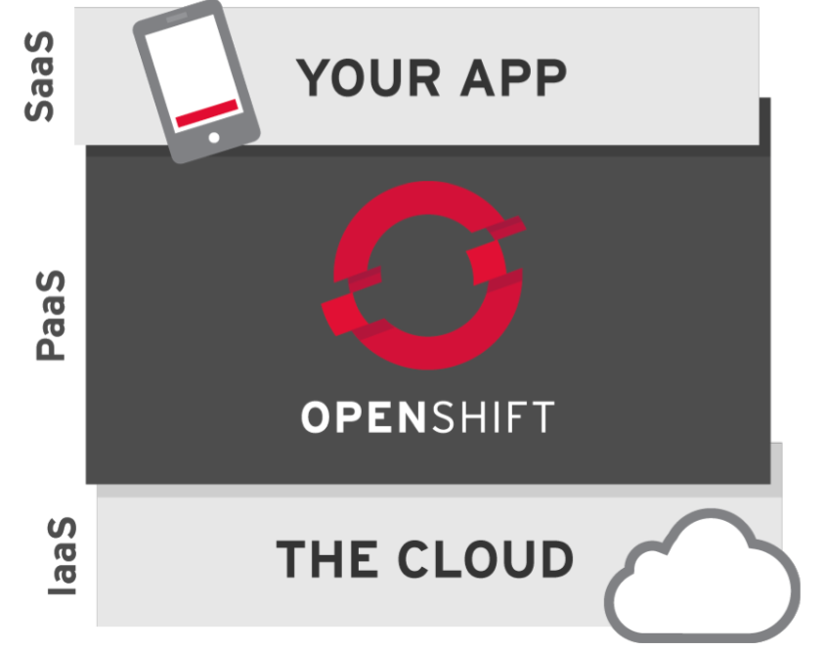
What is OpenShift?
Platform as a Service by RedHat
Open Source
Standards Based
Revamped for container technology
Different Flavors
In Cloud: Online/Dedicated
On-Prem: Enterprise
Build your own: Origin

Slide 5
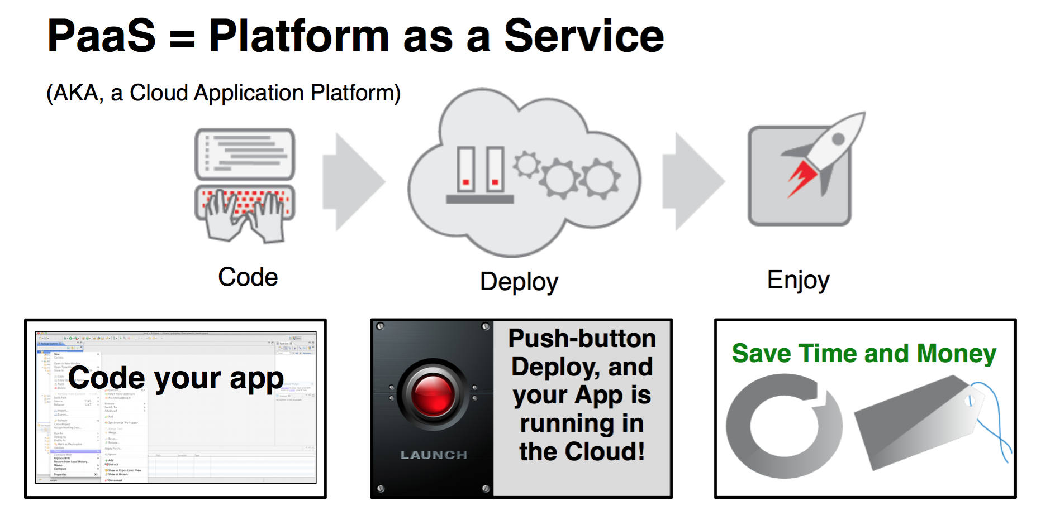

Slide 6
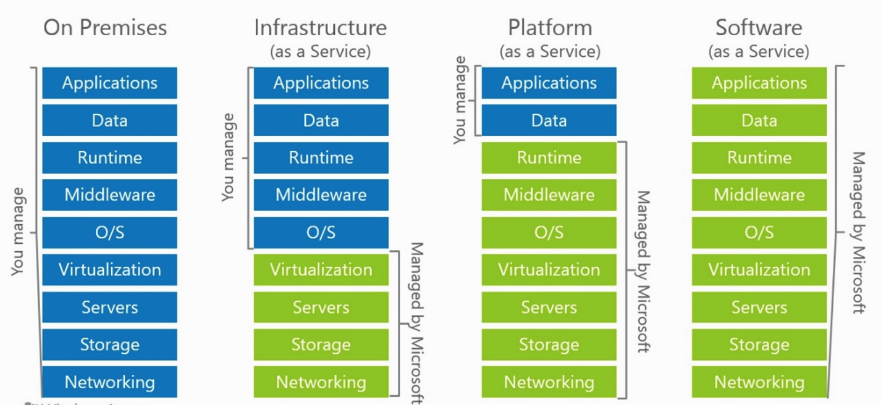
Separation of Responsibilities

Slide 7
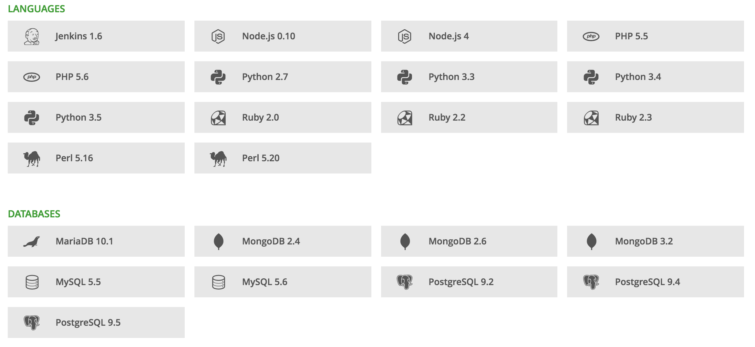
OpenShift Supported Languages & Databases

Slide 8
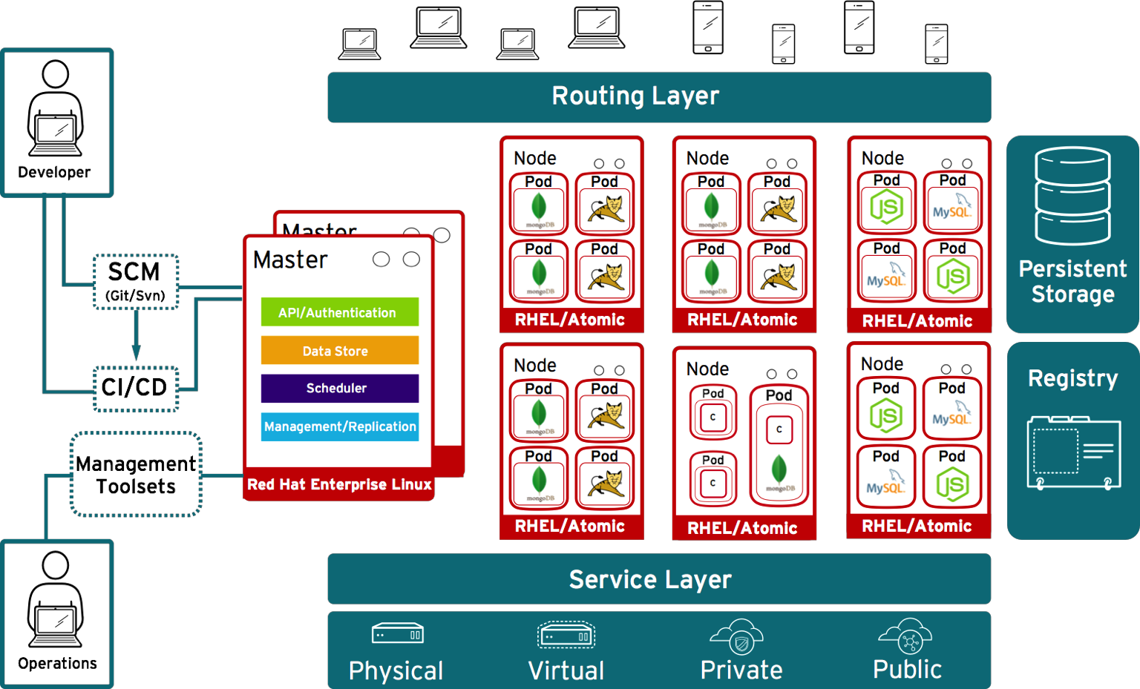

openshift.com

Slide 9

Runs on your choice of infrastructure
openshift.com

Slide 10
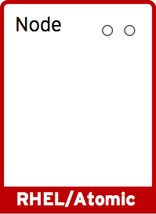
Nodes are instances RHEL where apps run
openshift.com

Slide 11




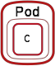

App services run in docker containers on each node
openshift.com

Slide 12
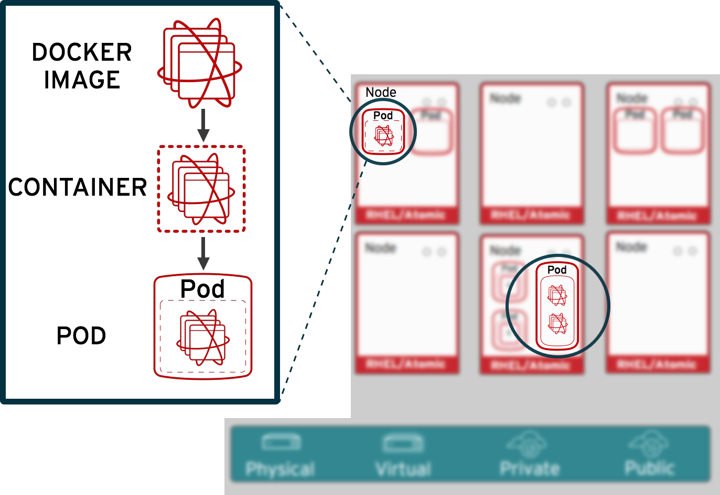
Pods run one or more docker containers as an unit
openshift.com

Slide 13
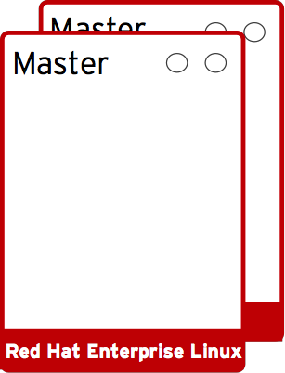

Registries keeps the application images
openshift.com

Slide 14






Masters manages API, scheduling & replication
openshift.com

Slide 15

When a pod goes down…
openshift.com

Slide 16
Openshift automatically recovers and deploys new pod
openshift.com

Slide 17
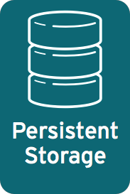
Pods can attach to shared storage for stateful services
openshift.com

Slide 18
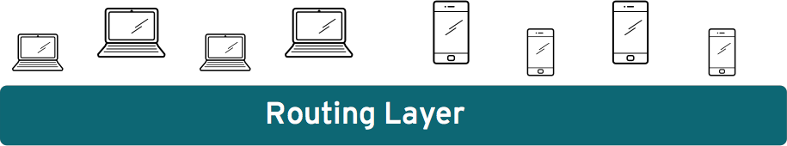

Routing layer routes external app requests to pods
openshift.com

Slide 19
Developers access OpenShift via Web/CLI/IDE
openshift.com

Slide 20
Containers Overview

Slide 21

Containers
Real world shipping containers
Same container efficiently transports goods by road, rail and sea
Contents remain untouched through all those environments; no repacking needed
Ubiquitous and standardized
Simple to use – open, fill, close
Contents of each container safe from the others
Know how much space the container consumes

Slide 22
Containers
Software containers
Build an image containing the full application stack only once
Spin up many containers from the same image in multiple environments
Laptop, data center, cloud
Development, QA, production, support
Simple to use & efficient
Contents of each container isolated from the others
Storage, memory, CPU, namespace
Constrain resources available to each container

Slide 23

Docker
The most popular container technology
Simple to use and has a rich ecosystem
100,000+ images available from Docker Hub
Including mongo hub.docker.com/_/mongo/
Syncs with GitHub projects
Define new images built upon base images
Define interfaces between containers
LINUX only (on OS X & Windows, transparently runs in a VM)
Runs on bare metal, VMs and cloud. Cloud providers supply the Docker infrastructure (e.g. Google Container Engine)
docker run -d mongo

Slide 24
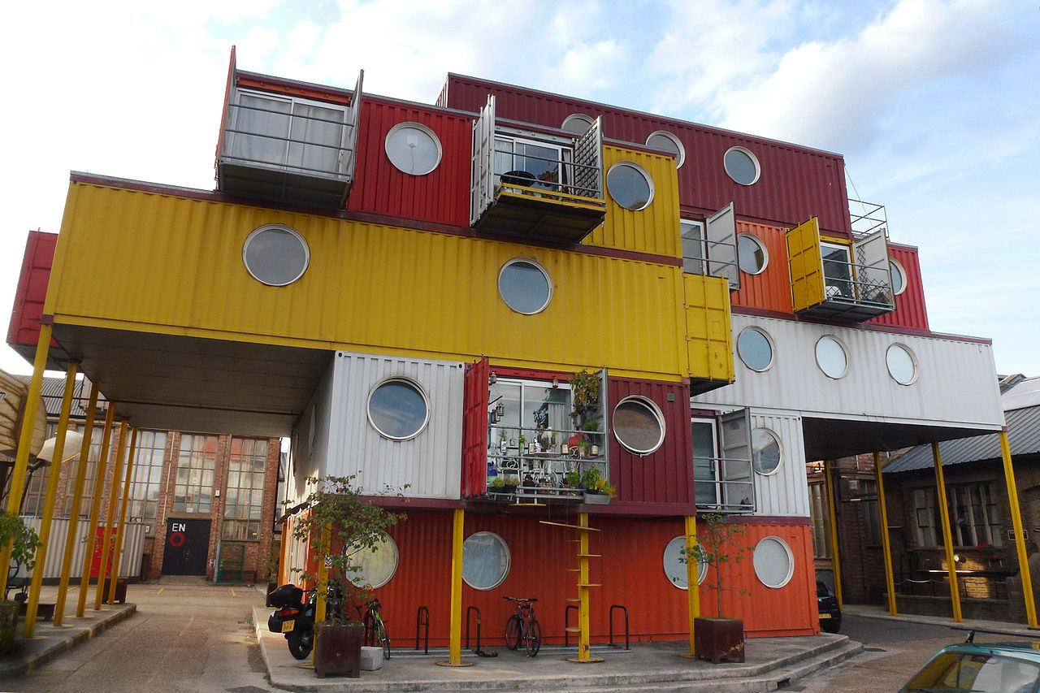
Microservices enabled by Containers
Microservices built by combining multiple containers
Build sophisticated services from many small, focused processes (containers)
Well defined APIs between components
Each component can use different libraries, middleware & programming languages
Modular, decoupled architecture simplifies maintenance and enables reuse
Fault tolerant
Scalable
Cmglee

Slide 25

Orchestration
Automated deployment, connecting and maintenance of multiple containers
Provision hosts
Instantiate containers
Reschedule failed containers
Link containers through defined interfaces
Expose services to the outside world
Scale out and back in

Slide 26
Orchestration Technologies
Docker Machine
Provisions hosts and installs Docker Engine
Used to run Docker on Windows and OS X
Docker Swarm
Provides single, virtual Docker host by clustering multiple Docker hosts
Often uses Docker Machine
Docker Compose
Deploys multi-container applications; including dependencies
Targets development, testing, and staging environments

Slide 27
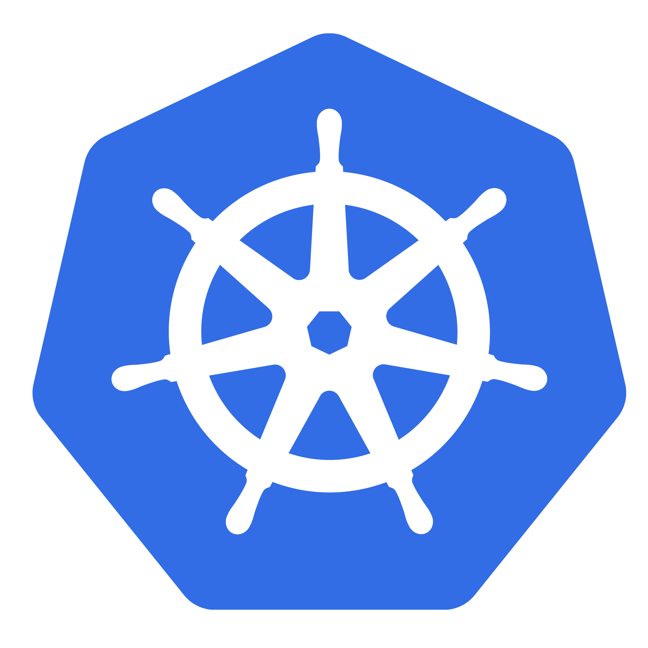
Orchestration – Kubernetes
Created by Google, feature-rich and widely adopted
Automated container deployment and ‘replication’
On-line scale out/in
Rolling upgrades
HA – automatic rescheduling of failed containers
Exposure of network ports to external apps
Load balancing over groups of containers providing a service
Provided as a service by Google Compute Engine

Slide 28
Orchestration – Kubernetes
Terms
Cluster: collection of nodes (bare-metal servers or VMs)
Pod: group of containers and volumes collocated in the same host. Containers share namespace & IP address
Volume: map ephemeral directories within container to external, persistent storage
Service: Load balancer and ambassador for containers – exposes port and external IP address
Labels: used to tag resources; labels are then referenced from other resources using selectors
Replication Controller: ensures the requested number of containers are always running

Slide 29

Orchestration – Apache Mesos
Designed to scale to 10,000s of physical servers; used by Twitter, Airbnb & Apple
Developer writes code to turn application into a framework to run on Mesos
Less feature rich than Kubernetes; considers many functions such as load balancing, rescheduling, and scaling to be a higher level function
Project exists to run Kubernetes as a Mesos framework
Foundation for distributed systems
Apache Aurora, Chronos, Marathon
Notes:
[Apache Aurora](http://aurora.apache.org/) – a highly scalable service scheduler for long-running services and `cron` jobs; it's used by Twitter. Aurora extends Mesos by adding rolling updates, service registration, and resource quotas.
[Chronos](https://github.com/mesos/chronos) – a fault tolerant service scheduler, to be used as a replacement for `cron`, to orchestrate scheduled jobs within Mesos.
[Marathon](https://mesosphere.github.io/marathon/) – a simple to use service scheduler; it builds upon Mesos and Chronos by ensuring that two Chronos instances are running.

Slide 30

OpenShift & Kubernetes
Built on top of Kubernetes
Storage
Quotas
Secrets
Deployment
Application templates
RedHat approved images
Notes:
[Apache Aurora](http://aurora.apache.org/) – a highly scalable service scheduler for long-running services and `cron` jobs; it's used by Twitter. Aurora extends Mesos by adding rolling updates, service registration, and resource quotas.
[Chronos](https://github.com/mesos/chronos) – a fault tolerant service scheduler, to be used as a replacement for `cron`, to orchestrate scheduled jobs within Mesos.
[Marathon](https://mesosphere.github.io/marathon/) – a simple to use service scheduler; it builds upon Mesos and Chronos by ensuring that two Chronos instances are running.

Slide 31
Containerizing MongoDB

Slide 32





Why MongoDB for Microservices?
Simplicity
Monitoring & automation
Scalability
Redundancy
Flexible data model
Notes:
[Apache Aurora](http://aurora.apache.org/) – a highly scalable service scheduler for long-running services and `cron` jobs; it's used by Twitter. Aurora extends Mesos by adding rolling updates, service registration, and resource quotas.
[Chronos](https://github.com/mesos/chronos) – a fault tolerant service scheduler, to be used as a replacement for `cron`, to orchestrate scheduled jobs within Mesos.
[Marathon](https://mesosphere.github.io/marathon/) – a simple to use service scheduler; it builds upon Mesos and Chronos by ensuring that two Chronos instances are running.

Slide 33


Considerations for MongoDB on OpenShift
Managing MongoDB Data
Replica Set Requirements (Use DNS/expose port)
Rack awareness Spreadness/Anti-Affinity
Performance & Diagnostic
Monitoring & Backup
Notes:
[Apache Aurora](http://aurora.apache.org/) – a highly scalable service scheduler for long-running services and `cron` jobs; it's used by Twitter. Aurora extends Mesos by adding rolling updates, service registration, and resource quotas.
[Chronos](https://github.com/mesos/chronos) – a fault tolerant service scheduler, to be used as a replacement for `cron`, to orchestrate scheduled jobs within Mesos.
[Marathon](https://mesosphere.github.io/marathon/) – a simple to use service scheduler; it builds upon Mesos and Chronos by ensuring that two Chronos instances are running.

Slide 34
1. Managing MongoDB Data
Consideration:
The data inside container instance does not survive re-scheduling
Recommendation:
Use Persistent Volume for your mongodb dbpath.
Provision PVs for your environment
Claim PV for each of your MongoDB dockers
Persistent Volume
Network attached storage
Lifecycle independent of pods/containers
Modeled as resources
Can only request by size. No IOPS/throughput guarantee
Notes:
[Apache Aurora](http://aurora.apache.org/) – a highly scalable service scheduler for long-running services and `cron` jobs; it's used by Twitter. Aurora extends Mesos by adding rolling updates, service registration, and resource quotas.
[Chronos](https://github.com/mesos/chronos) – a fault tolerant service scheduler, to be used as a replacement for `cron`, to orchestrate scheduled jobs within Mesos.
[Marathon](https://mesosphere.github.io/marathon/) – a simple to use service scheduler; it builds upon Mesos and Chronos by ensuring that two Chronos instances are running.

Slide 35
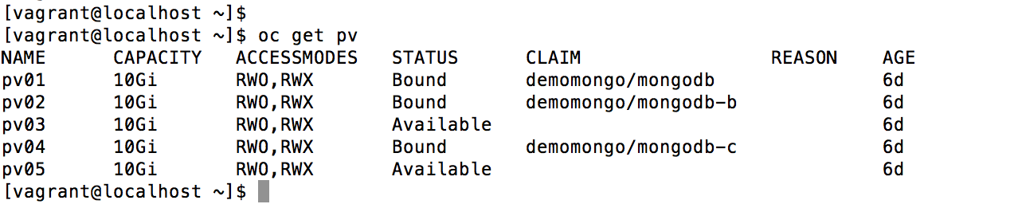
Persistent Volumes
Notes:
[Apache Aurora](http://aurora.apache.org/) – a highly scalable service scheduler for long-running services and `cron` jobs; it's used by Twitter. Aurora extends Mesos by adding rolling updates, service registration, and resource quotas.
[Chronos](https://github.com/mesos/chronos) – a fault tolerant service scheduler, to be used as a replacement for `cron`, to orchestrate scheduled jobs within Mesos.
[Marathon](https://mesosphere.github.io/marathon/) – a simple to use service scheduler; it builds upon Mesos and Chronos by ensuring that two Chronos instances are running.

Slide 36
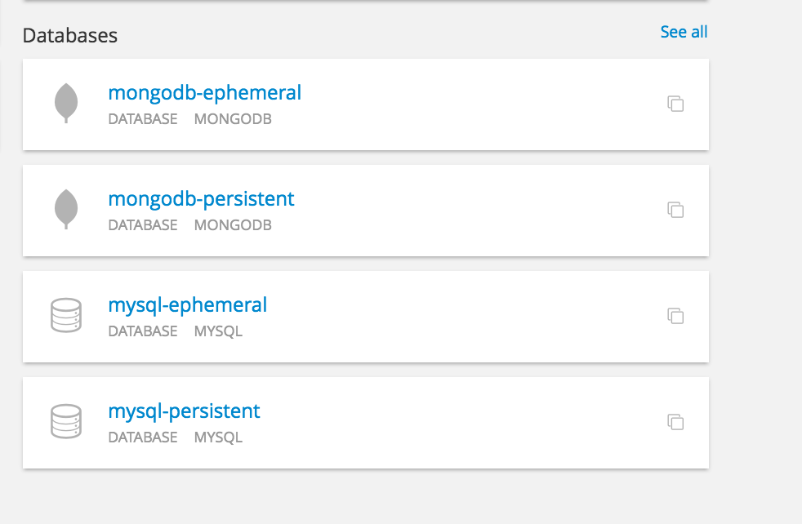
Add MongoDB in OpenShift
Choose appropriately
Notes:
[Apache Aurora](http://aurora.apache.org/) – a highly scalable service scheduler for long-running services and `cron` jobs; it's used by Twitter. Aurora extends Mesos by adding rolling updates, service registration, and resource quotas.
[Chronos](https://github.com/mesos/chronos) – a fault tolerant service scheduler, to be used as a replacement for `cron`, to orchestrate scheduled jobs within Mesos.
[Marathon](https://mesosphere.github.io/marathon/) – a simple to use service scheduler; it builds upon Mesos and Chronos by ensuring that two Chronos instances are running.

Slide 37
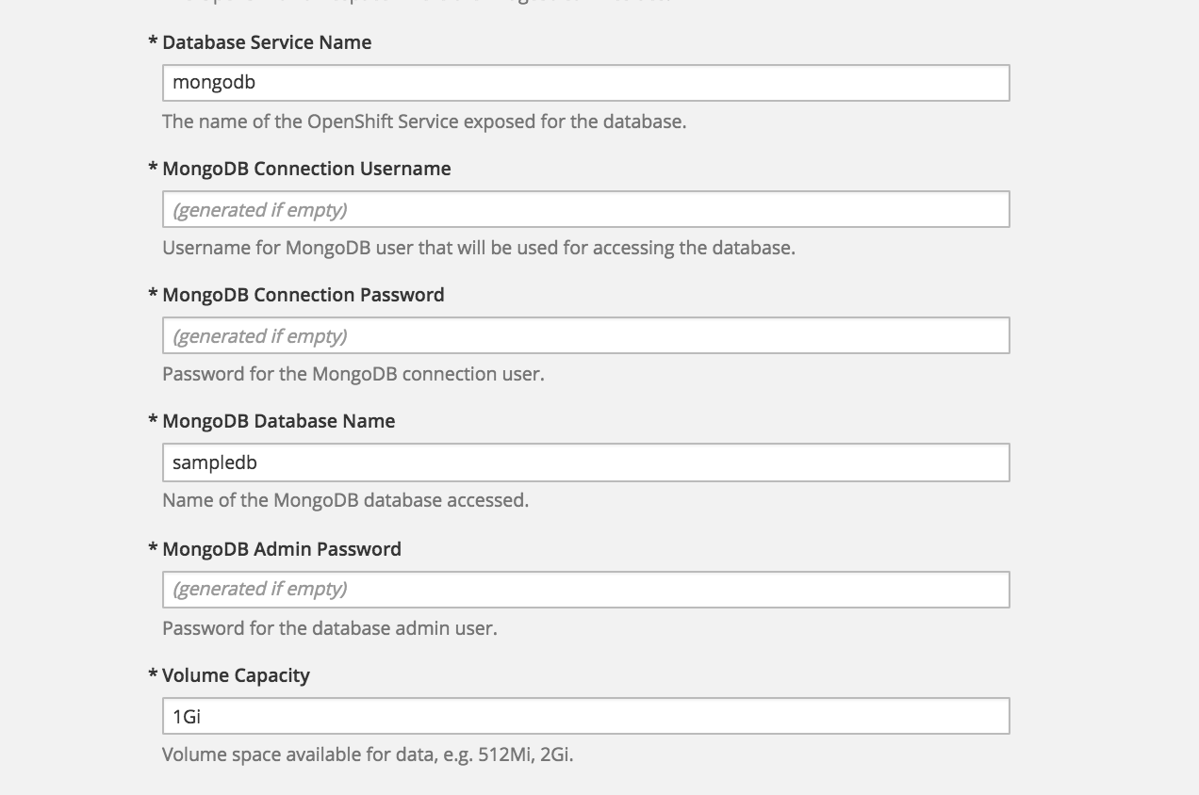
Add MongoDB in OpenShift
Size of PV
Notes:
[Apache Aurora](http://aurora.apache.org/) – a highly scalable service scheduler for long-running services and `cron` jobs; it's used by Twitter. Aurora extends Mesos by adding rolling updates, service registration, and resource quotas.
[Chronos](https://github.com/mesos/chronos) – a fault tolerant service scheduler, to be used as a replacement for `cron`, to orchestrate scheduled jobs within Mesos.
[Marathon](https://mesosphere.github.io/marathon/) – a simple to use service scheduler; it builds upon Mesos and Chronos by ensuring that two Chronos instances are running.

Slide 38
2. MongoDB Replica Set/Sharding
Consideration:
Replica Set/Shard members must be visible to each other
Replica set must be initialized out of band, not supported by OpenShift presently
Recommendations:
Configure appropriate Service (port forwarding) & Routes
Manage the MongoDB cluster membership via MongoDB OpsManager
Notes:
[Apache Aurora](http://aurora.apache.org/) – a highly scalable service scheduler for long-running services and `cron` jobs; it's used by Twitter. Aurora extends Mesos by adding rolling updates, service registration, and resource quotas.
[Chronos](https://github.com/mesos/chronos) – a fault tolerant service scheduler, to be used as a replacement for `cron`, to orchestrate scheduled jobs within Mesos.
[Marathon](https://mesosphere.github.io/marathon/) – a simple to use service scheduler; it builds upon Mesos and Chronos by ensuring that two Chronos instances are running.

Slide 39
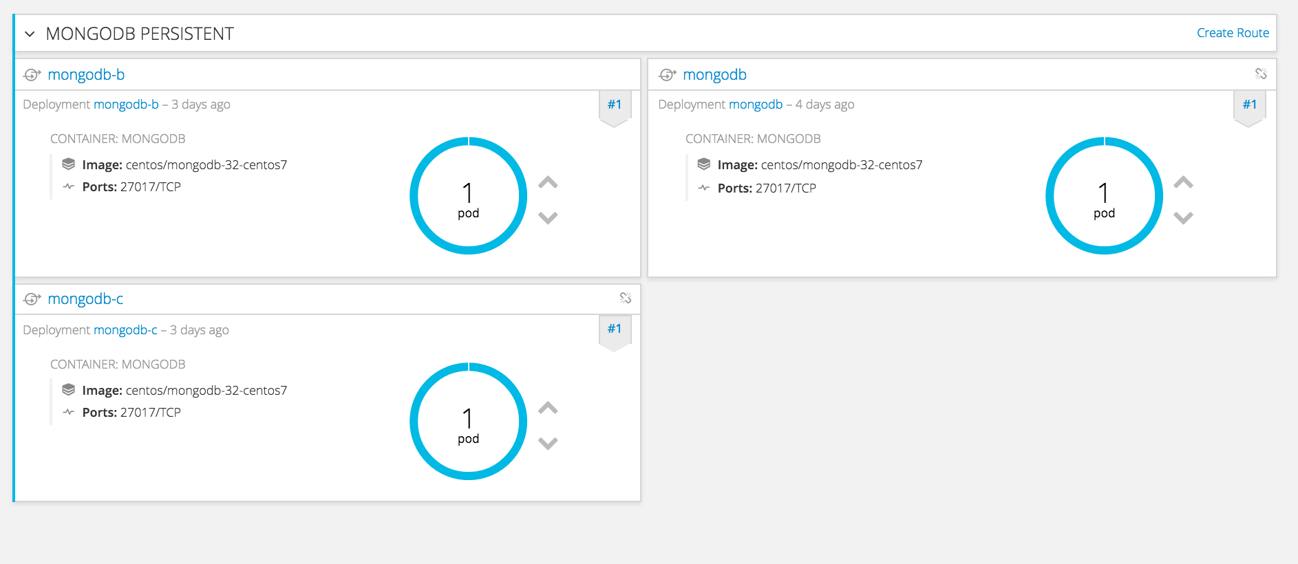

Initialize Replica Set
Ops Manager

Slide 40
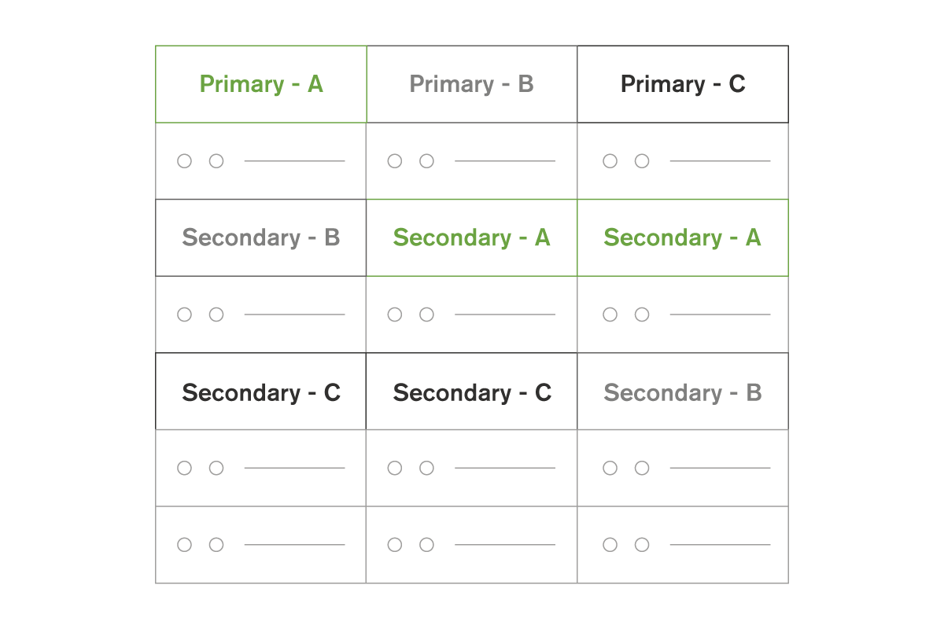
3. Rack/Zone Awareness
Consideration:
MongoDB provides own HA, nodes must spread over different racks/zones
Recommendations:
Configure OpenShift scheduler policy to use
ServiceSpreadingPriority
zone 1
zone 2
zone 3
Notes:
[Apache Aurora](http://aurora.apache.org/) – a highly scalable service scheduler for long-running services and `cron` jobs; it's used by Twitter. Aurora extends Mesos by adding rolling updates, service registration, and resource quotas.
[Chronos](https://github.com/mesos/chronos) – a fault tolerant service scheduler, to be used as a replacement for `cron`, to orchestrate scheduled jobs within Mesos.
[Marathon](https://mesosphere.github.io/marathon/) – a simple to use service scheduler; it builds upon Mesos and Chronos by ensuring that two Chronos instances are running.

Slide 41
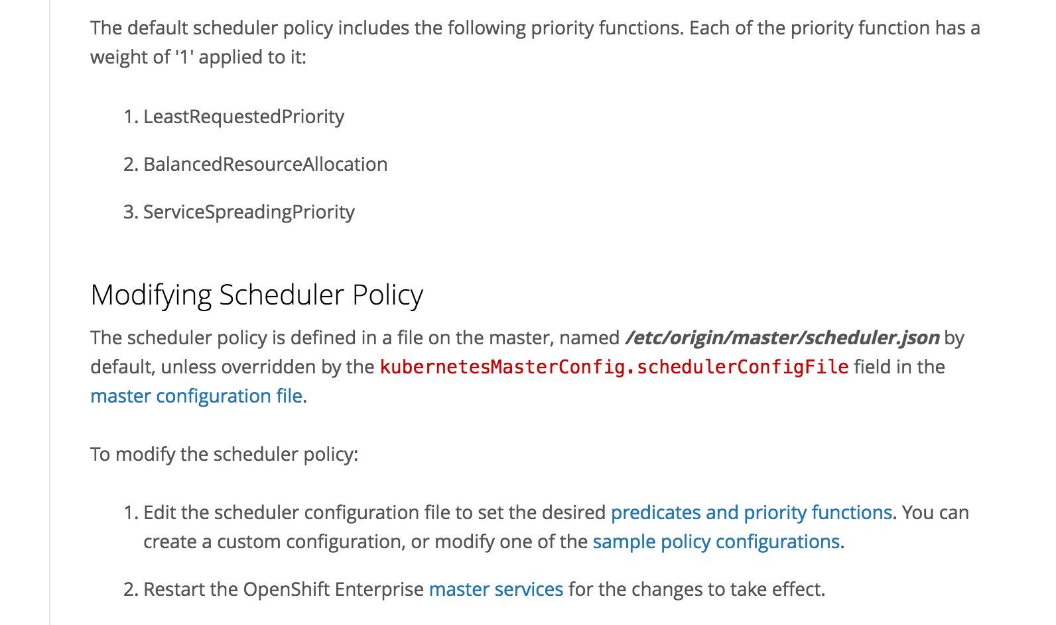
Modify Scheduler Policy
https://docs.openshift.com/enterprise/3.1/admin_guide/scheduler.html#modifying-scheduler-policy
zone 1
zone 2
zone 3
Notes:
[Apache Aurora](http://aurora.apache.org/) – a highly scalable service scheduler for long-running services and `cron` jobs; it's used by Twitter. Aurora extends Mesos by adding rolling updates, service registration, and resource quotas.
[Chronos](https://github.com/mesos/chronos) – a fault tolerant service scheduler, to be used as a replacement for `cron`, to orchestrate scheduled jobs within Mesos.
[Marathon](https://mesosphere.github.io/marathon/) – a simple to use service scheduler; it builds upon Mesos and Chronos by ensuring that two Chronos instances are running.

Slide 42
4. Performance & Diagnostics
Consideration:
IOPS/Throughput are key performance metrics but not well managed in OpenShift
Network attached storage are typically less performing than DAS
Recommendations:
Dedicated PV for mongodb pods, isolation from the storage layer
Optimize storage for Random IO
PING/Netstat utility on MongoDB docker image
Notes:
[Apache Aurora](http://aurora.apache.org/) – a highly scalable service scheduler for long-running services and `cron` jobs; it's used by Twitter. Aurora extends Mesos by adding rolling updates, service registration, and resource quotas.
[Chronos](https://github.com/mesos/chronos) – a fault tolerant service scheduler, to be used as a replacement for `cron`, to orchestrate scheduled jobs within Mesos.
[Marathon](https://mesosphere.github.io/marathon/) – a simple to use service scheduler; it builds upon Mesos and Chronos by ensuring that two Chronos instances are running.

Slide 43
5. Monitoring & Backup
Consideration:
OpenShift platform’s monitoring limited in system level
MongoDB has a few dozen db specific metrics
Database backup & restore is not managed by Openshift
Recommendations:
Using MongoDB’s OpsManager which provides:
Monitoring / Backup & Restore / Cluster management
Notes:
[Apache Aurora](http://aurora.apache.org/) – a highly scalable service scheduler for long-running services and `cron` jobs; it's used by Twitter. Aurora extends Mesos by adding rolling updates, service registration, and resource quotas.
[Chronos](https://github.com/mesos/chronos) – a fault tolerant service scheduler, to be used as a replacement for `cron`, to orchestrate scheduled jobs within Mesos.
[Marathon](https://mesosphere.github.io/marathon/) – a simple to use service scheduler; it builds upon Mesos and Chronos by ensuring that two Chronos instances are running.

Slide 44
OpenShift and OpsManager
OpsManager
Provision mongodb docker instance
Reschedule the pod when necessary
Monitor instance health
Manage storage, network, computing resources
Initiate Replica Set
Manage the cluster relationship
Monitoring mongodb specific metrics
Backup
Scale out

Slide 45
How can we help? MongoDB Enablement
Consulting, training, and professional services throughout your project lifecycle
Design & Development | Pre-Production (Test, QA, Deployment) | Production | Expansion
Dedicated Consulting Engineer | Custom Projects
Operations Rapid Start | Production Readiness |  | MongoDB Private Cloud Accelerator
 | Health Check
Development Rapid Start | Performance Evaluation and Tuning
For Operations
For Both
For Developers
Notes:
We offer professional service for all teams throughout your development lifecycle, from design to production.

Slide 46
Q&A

